Slide 1
ETL Project:
Bexar County Covid-19 by the Numbers
Rosanna, Chris, and James

Slide 2
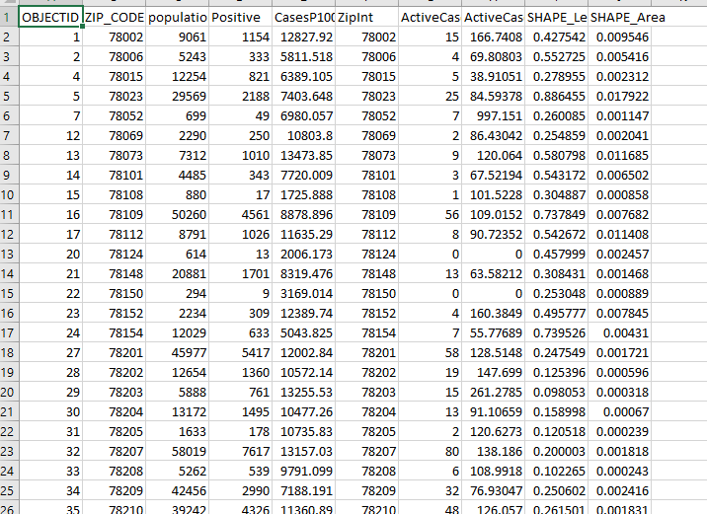
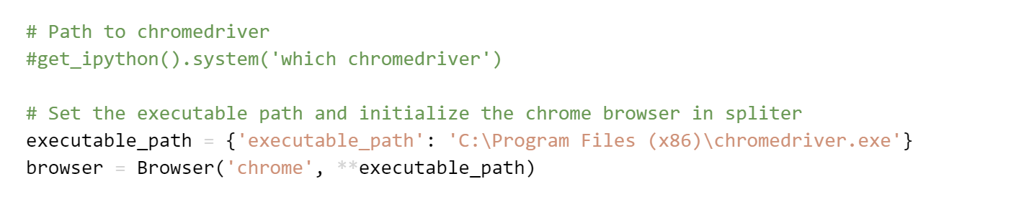
Extract
Data was updated from the following sources:
https://cosacovid-cosagis.hub.arcgis.com/datasets/bexar-county-covid-19-data-by-zip-code/explore?location=29.436913%2C-98.459202%2C10.87
https://data.democratandchronicle.com/covid-19-vaccine-tracker/texas/bexar-county/48029/
All of our data was based on Bexar county.

Slide 3
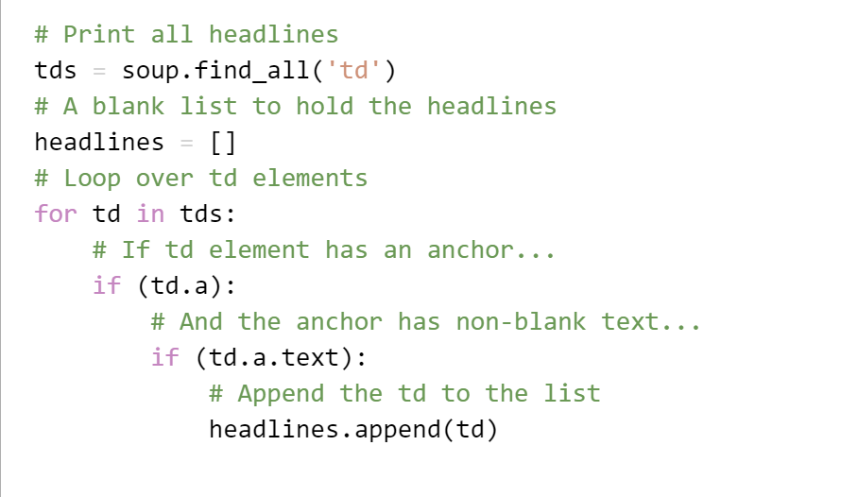
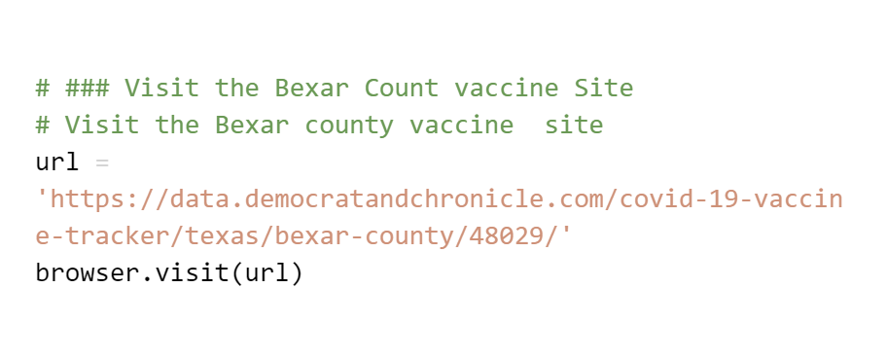
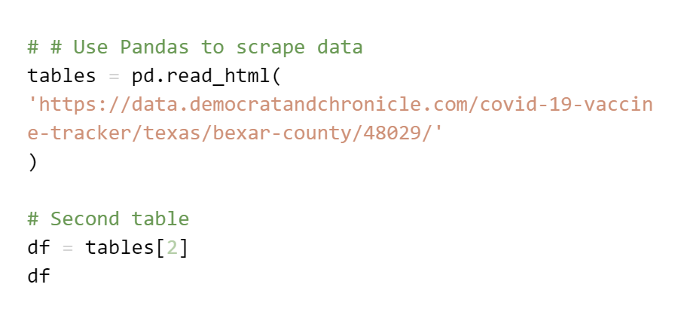
Transform
Our first steps in cleaning up the datasets involved updating the most recent vaccine information from all Texas counties and transferring it from HTML to a Pandas Dataframe. We also pulled updated Census Bureau CSV to incorporate updated positive case count numbers in Bexar county

Slide 4
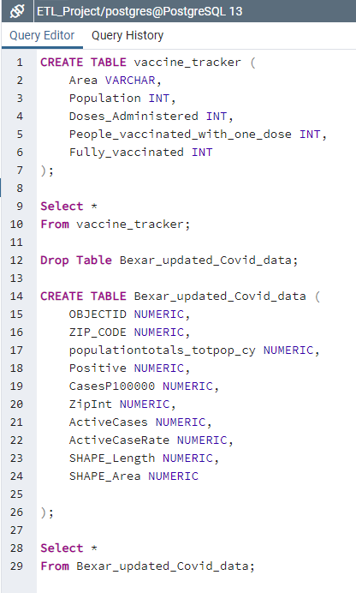
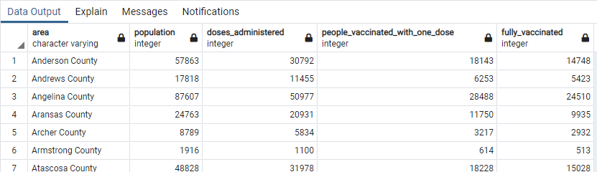
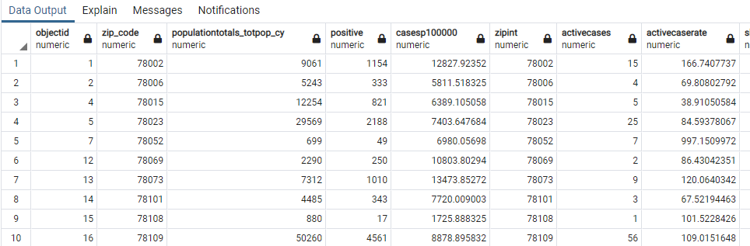
Load
The last step was to transfer our final output into a Database. We created a database and respective tables to match the columns from the final Pandas DataFrame using MYSQL and then connected to the database using SQLAlchemy and loaded the result. utilized PgAdmin

Slide 5
Questions?

